Slide 1

Bank Loan Analysis

Slide 2
Abstract
The purpose of these models is to predict the prospective customers of a bank that will accept a personal loan based on the person’s previous behavioural data. Using these model, the bank will be able to target potential customers and hence increase the number of personal loans.
The predictive models are either Regressive models(continuous output) or Classification models(categorical output). In this case, the output is clearly categorical. The customer can either take a personal load or not, hence, this model is a classification model. The output can either be a class output or a probability output. Class outputs are binary in nature, i.e., either 0 or 1, Also, before building any machine learning model, it is very necessary to note the misclassification cost of each class. It is also very important to choose a proper metrics(For classification model: accuracy, sensitivity, precision) for evaluation of the model’s performance. In order to choose between the accuracy or sensitivity and precision, the misclassification costs of each class should be known.

Slide 3
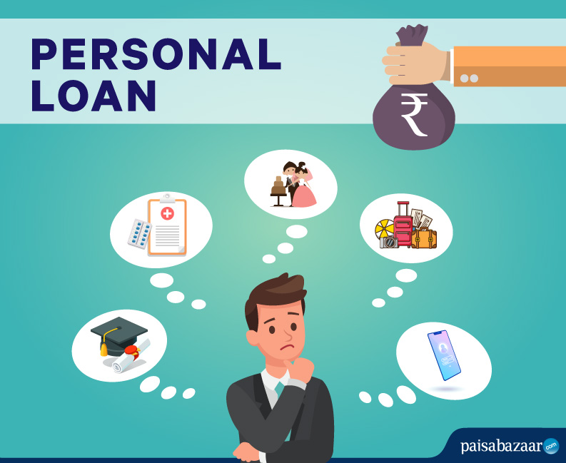
Objective of the study
The objective is to target the right customer segment for personal loan.
Marketing departments across sectors welcome user data to help them make key decisions. But a clear marketing strategy can be hard to define as marketers are increasingly bombarded with disorganized customer information and big data.
AI and machine learning are helping the top minds in Banking as they drive the performance of forward-thinking brands and target the right kinds of customers.

Slide 4
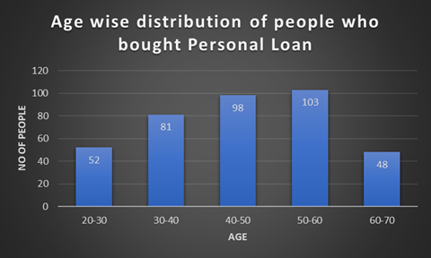
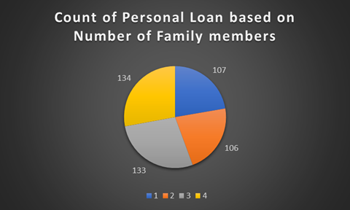
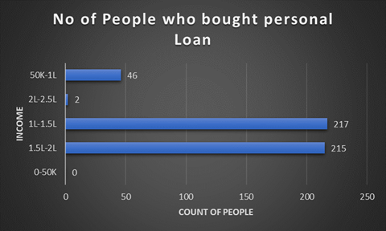
Overview of the Dataset Used:
The Dataset set contains total 16 columns and 5000 Rows and was downloaded from Kaggle: Bank_Loan_Classification.
It Contains Following Columns:
Column Name | Type
ID | Integer
Age | Integer
Experience | Integer
Income_group | Integer
Income | Integer
ZIP Code | Integer
Family | Integer
CCAvg | Float
Education | Integer
Mortgage | Integer
Personal Loan | Integer
Securities Account | Integer
CD Account | Integer
Online | Integer
CreditCard | Integer

Slide 5
Advantages of using Machine learning models
With the help of machine learning models, we can save time and money
We can easily identify what customers to target
It will automate the process of targeting the customers

Slide 6
Data processing steps
Import libraries and data set
Check Null values
Check the data type of each variable
Drop columns which are not significant (ID and Zip column)
Find the correlation between independent variables.
Split the data into training and testing
Run different machine learning models and use accuracy to analyse their performance
Find the best fit model

Slide 7
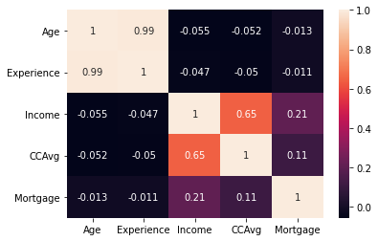
Correlation plot
A correlation matrix is a table that shows the coefficients of correlation between variables. The association between two variables is shown in each cell of the table. A correlation matrix may be used to summaries results, as an input to a more advanced analysis, or as a diagnostic tool for advanced analyses.
Here we can see from the plot that age and experience are highly correlated to each other as the value is 0.99.

Slide 8
Machine learning models used
Logistic Regression – 94.4 %
Naïve base model – 89.7 %
Random Forest – 98.7 %
SVM model
c = 2 , gamma value = 0.002 (most optimized model at these points)
Kernel = Linear , accuracy = 94.9 %
Kernel = RBF , accuracy = 94.5 %
C value | Accuracy
1 | 97.6%
2 | 97.8%
Gamma | Accuracy
0.002 | 94.1%
0.001 | 92.5%

Slide 9
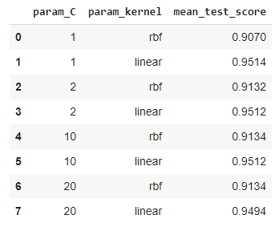
Values using GridSearchCV & RandomizedSearchCV
SVM – best at c=1, kernel=linear, 95.14%
KNN model – 95.5 %
Decision tree – 98.4 %
Random Forest – 97.4 %

Slide 10
Conclusion
The model using decision tree with GridSerachCV was able to predict with accuracy of 98.4 %
This model can predict who will avail the personal loan more accurately by mentioning their income, experience etc.

Slide 11
References
Data set - https://www.kaggle.com/sriharipramod/bank-loan-classification
Model - https://colab.research.google.com/drive/1Ae6RAHqQuw5MkB3mIdEyVRhWC41A3XXT?usp=sharing

Slide 12
Thank You!

